Slide 1
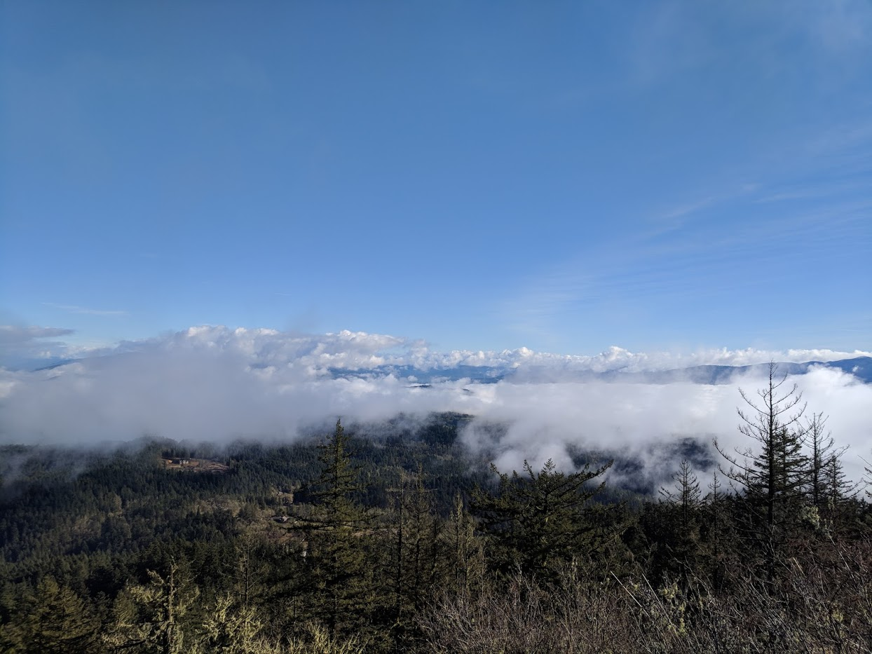
Monitoring Design
U.S. Department of the Interior Bureau of Land Management
Sample frames, reporting units, and stratification
Notes:
Hello! My name is Nelson Stauffer and I’m a computational biologist with the USDA Jornada Experimental Range.
In this presentation, I'll be covering monitoring design for the BLM Assessment, Inventory, and Monitoring Strategy, commonly referred to as referred to as AIM

Slide 2
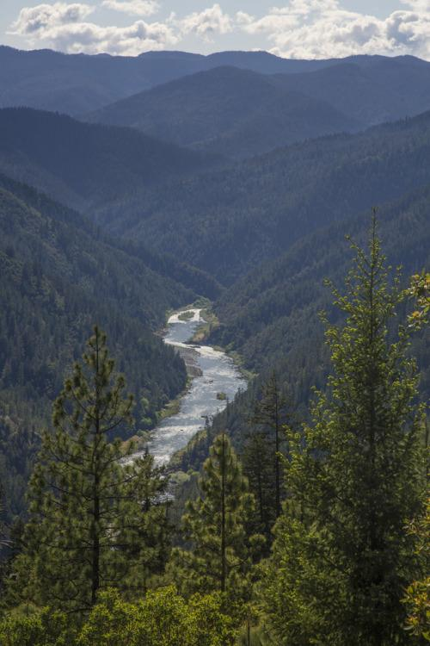
Objectives
After this presentation, you will be able to:
Define monitoring design​
Major features of a monitoring design
Sample frame
Reporting units
Stratification
Selecting appropriate design strategy
?
?
?
?
?
Notes:
In this presentation, we will cover: What monitoring designs are
Their major features (including the sample frame, reporting units, and stratification)
and how to determine which sample drawing approach is best for a given design.

Slide 3
What is a monitoring design?
Loosely defined term that encompasses technical aspects of creating a monitoring program
Includes:
Defining sample frame (resource of interest)
Reporting units
Stratification (if any)
Sample site selection
Plan for implementing/managing the sample design
Notes:
So what is a monitoring design?
The term is loosely defined, but covers the technical aspects of creating a monitoring program
This includes decisions that:
Define the sample frame, sometimes called the resource of interest
Decide the reporting units that guide analysis
Determine the stratification scheme if any
Establish the method by which sample locations are selected
Lays out the plan for implementing and managing the both the data collection process and data themselves

Slide 4
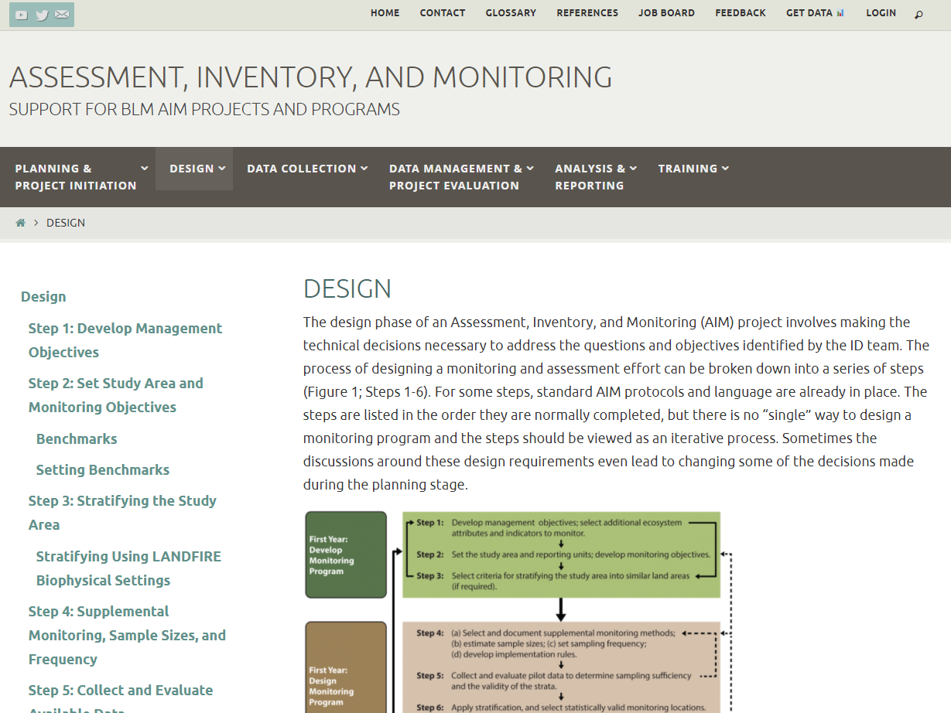
https://aim.landscapetoolbox.org
Notes:
As a note: For later reference or clarification, you can find specific information, guides, and documents at aim.landscapetoolbox.org

Slide 5
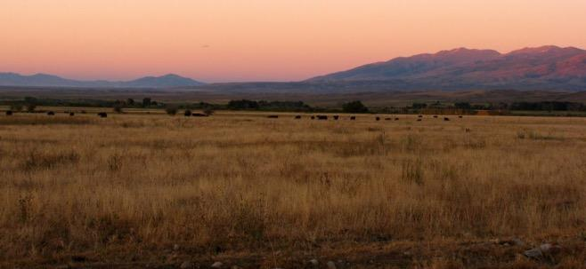
What does a monitoring design do?
Select a representative sample from a resource of interest in order to estimate attributes of that resource in an unbiased and cost-effective manner.
Notes:
So what does a monitoring design do?
It selects an representative sample from a resource of interest in order to estimate attributes of that resource in an unbiased and cost-effective manner.
Each of the emphasized terms in that statement are decision points which are considered as part of the process of creating a sample design.

Slide 6
Sampling to monitor natural resources
Most of the time we can’t measure all of the resource we’re interested in
Sampling
Using measurements from a selected subset to estimate attributes of the entire resource
Lots of different ways to pick a sample
Sampling is “statistically valid” if it gives an unbiased estimate of the resource
Notes:
Why do we sample?
For even comparatively small areas, it’s almost always impossible to measure every part. So instead we sample, meaning we collect data on a small part of the landscape which we can then use to describe the whole area.
There are multiple ways to define and select the sample, but the important feature of a sample is that it is as unbiased as possible. When we use the term “unbiased” we mean that the sample is as representative of the whole as possible, meaning that for anything we measure about the sample we expect that we’d get the same result from measuring the whole if we could.

Slide 7
Sampling Examples
Estimating the makeup of a bag of M&Ms
Estimating TV viewership via Nielson Ratings
Notes:
Here are a few examples.
If we wanted to know the proportion of green M&Ms in a 20 lbs bag of M&Ms, we probably wouldn’t want to sort and count all 20 lbs. That would be a census and give us an exact value, but it's time-consuming and frankly boring. Instead, we can shake up the bag and without looking draw out a few handfuls to act as our sample for the population. By counting those, we can determine the proportion of green M&Ms in the sample and use that as an estimate of the proportion of green M&Ms in the whole bag. Without the randomization of shaking and not looking, the odds of introducing a bias by grabbing handfuls that have skewed proportions are higher.
As another example, we could think about TV ratings. For broadcast TV, there’s no way of knowing exactly how many people watched a given show. So to estimate the viewership of something like the Superbowl, a subset of households are asked whether or not they watched the event and—based on the proportion of that sample that says, “Yes,”—we can estimate the overall proportion of US households that watched. That proportion can in turn be used to estimate the number of people who saw it. This sample would be biased if only households with members who have “their team” playing in the Big Game are asked. We know that odds are that that sample would not be representative of the whole population because we’d expect that they would be more likely to watch than a randomly selected person. This bias would result in an overestimate of viewership for the population.

Slide 8
Steps to creating a design
Define a sample frame (population/resource of interest)
Define reporting units
Select a stratification approach
Evaluate existing/pilot data
Determine sample sizes, sampling frequency
Select sampling locations
Notes:
Now that we've talked about sampling in general, what goes into an AIM monitoring design specifically?

Slide 9
Steps to creating a design
Define a sample frame (population/resource of interest)
Define reporting units
Select a stratification approach
Evaluate existing/pilot data
Determine sample sizes, sampling frequency
Select sampling locations
Notes:
We'll be talking about steps one through three—sample frames, reporting units, and stratification—in this presentation. Steps four through six are important too, but are done in partnership with the National AIM Team

Slide 10
Sample Frame
Related to the statistical term “population”
Target population: What/where you want to know about, AKA the sample frame
Sample population: The places are actually visited and evaluated or have data collected
Be careful not to unnecessarily restrict the sample frame
Risks introducing unintended bias
Reduces the area/length that the data describe
Notes:
Defining a sample frame is the first step. You may be familiar with a few related terms like “population,” “study area,” or “resource of interest.” The sample frame is very slightly different from a resource of interest or study area, but is a kind of population.
Specifically, a sample frame as we mean it is the same thing as a target population: An area (or length of stream) that you are targeting to know more about. It includes all the area or length that you want to know about and nothing that you don’t. This is in contrast to study areas and resources of interest which might include parts of a landscape that you wouldn’t be sampling. For example the study area for post-fire monitoring might be defined with the burn perimeter, but, for the BLM, the sample frame would limited to only be the BLM land that burned in that area.
The sample population is the collection of places within the target population that are actually sampled, that is, places that are visited and evaluated or data are collected from.
It is critical to not over restrict the sample frame! As you restrict it, you can introduce unintended or unmanageable bias, for example removing all land too far from roads using an incomplete GIS layer for the roads could mean that you would fail to sample some places which were in fact accessible and relevant.
Additionally, the smaller the sample frame, the smaller the area that you can make inference to from your data. So a smaller sample frame means more limited application of the data.

Slide 11
Sample Frame
Defines the extent of the resource you’re interested in
E.g. All BLM lands in a Field Office; all perennial streams within a allotment; all fire treatments within a fire boundary
Maximum area you want to draw conclusions about
This is not a trivial task!
Notes:
So, the sample frame is the full extent of the resources that you need to draw inference to, e.g. all BLM lands in a Field Office; all perennial streams within an allotment; or all fire treatments within a fire boundary
This can be tricky, so spend the time to make sure that you haven’t made choices that you’ll regret and have to work around when using the data later!

Slide 12
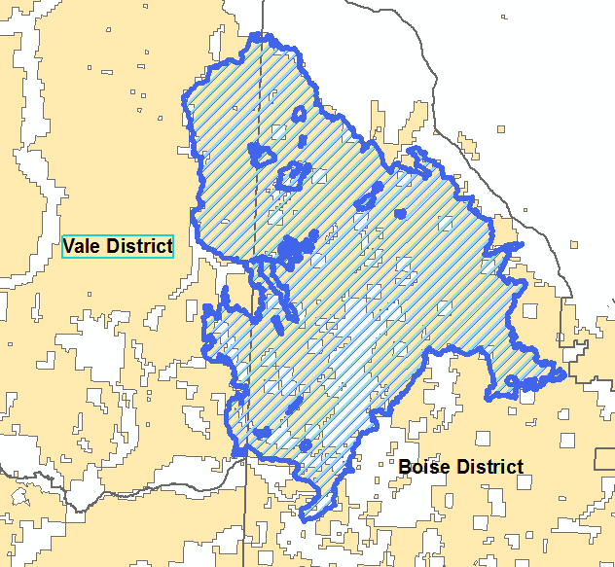
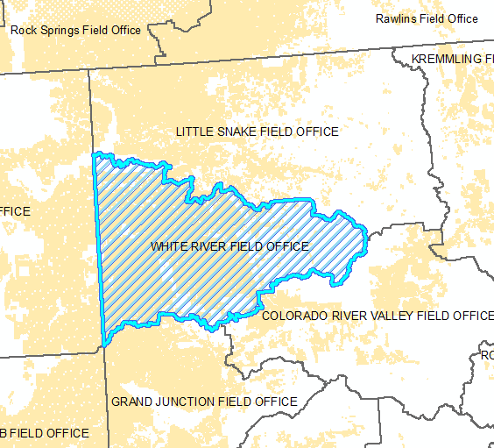
Study Area versus Sample Frame
Soda Fire, Idaho/Oregon
White River FO, Colorado
Notes:
These two images show the difference between a study area and a sample frame for the Soda Fire and a Land Use Plan evaluation project. Study areas like the burn perimeter and field office boundaries here are useful to know for a project because they can be helpful for mapping. The sample frames, however, are the BLM land (in yellow) within these boundaries because those are the places that the BLM has the authority and responsibility to monitor and manage.

Slide 13
Reporting Units
Subsets of the study area that you need summary information about
E.g. watersheds, allotments, GRSG habitat units
May have multiple and even overlapping reporting units
Not restricted to a single type for a project
Reporting units should be stated in your monitoring objectives
Knowing them ahead of time helps ensure adequate sampling
Notes:
Reporting units are simply areas that you want to answer questions about. They are used to subset the available data before analysis so that each reporting unit is described only with data from within its boundaries.
If you need to report on the condition of watersheds, then you can use the watershed boundaries as a set of reporting units. You could also report on seasonal sage grouse habitat and allotments. It doesn’t matter that these three examples may all overlap; because each reporting unit is considered on its own when analyzing the data, having overlapping reporting units has no effect on the results.
The primary limitation is that whatever portion of a reporting unit isn’t covered by the sample frame CANNOT be described with statistical analyses of the data. Those areas would need to be addressed by some other means like key area monitoring.
By defining the expected reporting units before the design is drawn, you can make sure that your design will adequately sample in those reporting units. More reporting units can be defined later, but they may not have the same level of coverage.

Slide 14
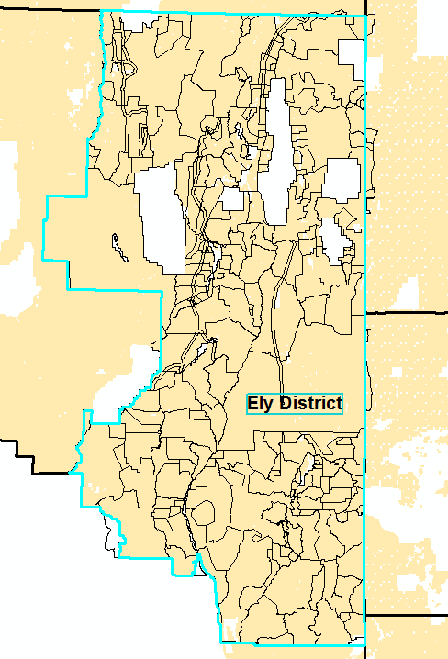
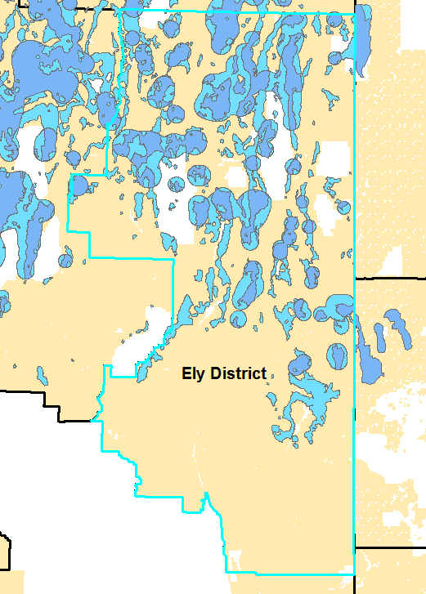
Reporting Unit Examples
Allotments
GRSG Population Areas
and/or
Notes:
These two maps both show the Ely District Office. On the left are the polygons for allotments and on the right are the population areas for Greater Sage-Grouse. Every polygon here is a valid reporting unit and both kinds could be used with data from the Ely District Office. They could even be combined to answer questions about sage grouse habitat within specific allotments.

Slide 15
Stratification
Stratification is the optional dividing of a sample frame up into discrete subunits called strata to allocate effort on a per-stratum basis
Reason to stratify:
Variability in indicators may be dramatically different across the landscape
Ensure important but uncommon land/resource types are sampled
Notes:
Stratification is a way to both divide up and plan sampling effort within the sample frame. When you use stratification and create strata, you can control how many sampling locations are in each stratum.
Strata resemble reporting units in that they could be polygons based on anything, but unlike reporting units a sample design has only one set of strata and they cannot overlap with each other
Stratification is powerful and can help you in a few ways. There are two very common reasons to stratify:
First, you know that some of the landscape is highly variable and will take a lot of sampling to characterize. By putting the variable parts of the landscape into a stratum, you can put more sampling effort there while still being able to characterize the homogeneous parts of the landscape with fewer samples.
Second, you know that there are important places to sample but they’re small and unlikely to have any sampling locations placed in them at random. By creating a stratum with those, you can ensure that some of the sampling effort goes towards those areas.

Slide 16
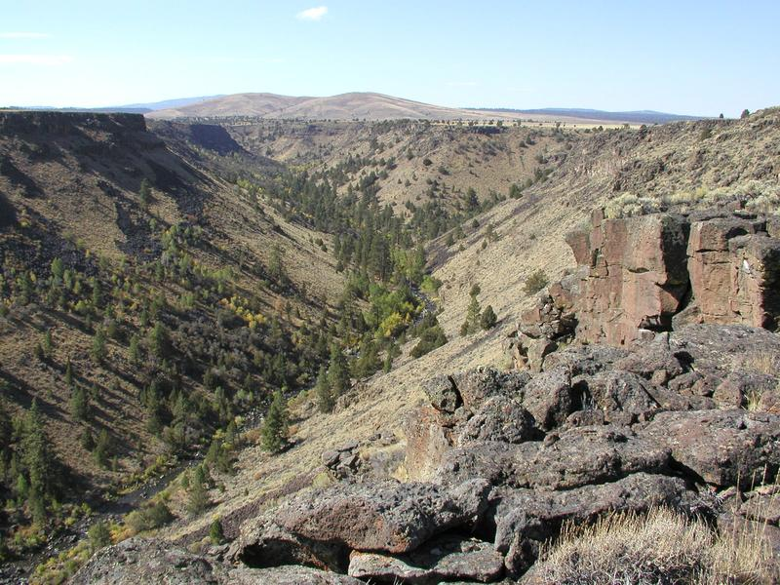
Stratification by land type
Notes:
Because variability in the landscape is often tied to the ecological potential of the landscape, strata in AIM have frequently been created using land types or ecological potential.
In this image there are a few proposed strata: Riparian areas down along the intermittent stream, Dry Slopes leading down to the riparian areas, Rocky Outcrops in the foreground, and Steppe in the distance on the plateau.
Strata can come from multiple sources but the strata themselves still need to completely cover the sample frame without overlapping. For this example, we could decide that we'll have a stratum for sage grouse habitat then break all non-habitat areas into strata based on land types. We could also combine the land type and habitat to get strata like "steppe in habitat" and "steppe outside of habitat" but that approach can cause the number of strata to explode as the number of unique combinations can be huge.

Slide 17
Pros and Cons of Stratifying
Benefits
Can ensure adequate coverage for critical and/or uncommon areas
Can make sampling more efficient if strata correspond to indicator variability
Drawbacks
Adds complexity to the design and can dramatically complicate analyses
Can make sampling less efficient, especially with too many strata
Notes:
Stratification has its benefits, but is not without cost.
As stated before, stratification can help you to ensure sampling coverage of critical or uncommon land types.
It can also make sampling more efficient if your strata effectively represent areas of homogeneity. A more homogeneous stratum can be characterized with fewer sampling locations, freeing up some of your sampling effort for other strata. For example, if you have a lot of very similar grassland in one stratum and highly variable shrubland in another stratum, you could put more sampling into the shrubland and still get enough data to describe the grassland.
However, stratification can greatly complicate the reuse and recombination of data in the future to answer other questions. In worst case scenarios, interaction between different stratification schemes in a multi-design analysis can actually result in a smaller inference area than any of the designs had on their own!
It can also lead to inefficient and even inadequate sampling if the strata are not homogeneous enough. If a stratum is highly variable but doesn't receive much sampling effort, you may be worse off than if you simply hadn't stratified in the first place.
And if you go wild and have a large number of strata, each one will receive less effort simply because there are more to spread the sampling across. If you can sample 30 points and have 15 strata, then you won't have more than one or two points in each, which will almost certainly not be enough.

Slide 18
Strata Versus Reporting Units
Strata
Reporting Units
Cannot overlap
Only one stratification scheme per design
All strata must be sampled
Strata are set in stone for a design
Can overlap
No limit to number or type of reporting units
Reporting units can change over time, including the addition of new ones
Limited by data availability
Not all reporting units need to be sample
Notes:
Remember, strata and reporting units are similar, but not the same thing.
On the stratification side of things:
Strata can't overlap, but they do need to cover the entire sample design.
You can also only have one set of strata for a design.
Every stratum in the design needs to be sampled. Any stratum without data is effectively dropped from your sample design and becomes a blank spot for any reporting.
Once your design has strata, you’re committed to them for the lifetime of that design. In order to change strata you sample by, you'd be starting a whole new design.
Reporting units on the other hand can overlap because every reporting unit is considered on its own during analyses.
There’s no limit to how many or what types of reporting units you have. You could treat every allotment and stream reach as its own reporting unit, if you like.
And you can always add more reporting units or change them in the future as new reporting needs arise
You are, however, limited by the extent of data. Only parts of a reporting unit that overlap with the sample design and have data in them can be reported on. Anything outside the sample frame is outside the inference area for the data.
If a reporting unit ends up unsampled, the overall design does not suffer but you still can't report on that area.

Slide 19
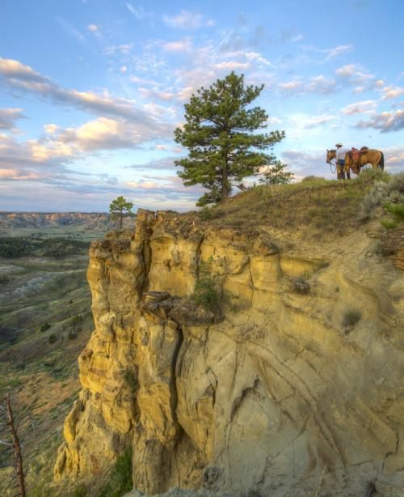
What is an “appropriate design?”
Random or targeted
Objective driven
Short term
Treatment effectiveness
Grazing permit renewals
Long term
Land Use Plan (LUP) effectiveness determinations
Unknown future questions
Notes:
Until this point, we’ve only addressed random designs, but there are alternatives including targeted (also known as key area) monitoring.
Deciding which approach is best depends on what objectives your project has.
Short term and smaller scale objectives like evaluating treatment effectiveness or carrying out grazing permit renewals can benefit from including key area monitoring. Long term and larger scale objectives like evaluating Land Use Plan effectiveness or trying to make sure that your data can be applied to future questions generally call for a random approach.

Slide 20
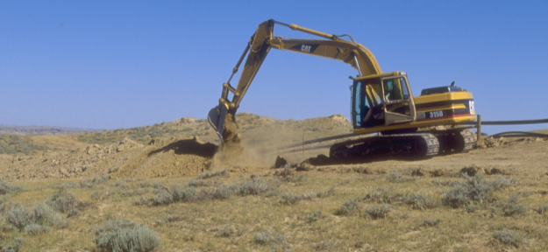
Key Areas & Targeted Monitoring
Focused on specific land uses (e.g. grazing or stream restoration)
Cannot apply data to larger population with statistical analyses
Can underestimate heterogeneity
Sensitive to disturbance or loss
Notes:
With key area monitoring, you select your data collection locations based on the particular questions at hand. If you’re working on a grazing permit renewal, then you would select places that are representative of the allotment and would reflect grazing-related issues. Likewise, for stream restoration you would pick a stretch of the stream which you think represents the whole length of stream being treated.
Because these kinds of plots are non-random, they cannot be used larger statistical analyses, but they can be interpreted as characterizing the areas they represent.
Key area sampling runs the risk of underestimating how varied a landscape is, however, because it makes assumptions about what is representative. By picking even a handful of locations it can still be easy to miss other types of land that the selected locations do not represent.
They are also sensitive to disturbance or loss. For example, if a single targeted location represents a large area but is also burned as part of a small fire, it no long represents that larger area well.

Slide 21
Key Areas & Targeted Monitoring
Key areas are informative for land use effects
Key areas and statistical sampling can complement each other
Strong monitoring programs often use both key areas and statistical sample designs
Notes:
Key areas selected based on land uses therefore reflect and are informative for understanding the effects of those land uses
Random and key area approaches aren’t mutually exclusive though and can in fact complement each other. You can use data from a random design to interpret data from targeted data collection.
In one common situation, you might have a grazing permit renewal for an allotment with no random sample locations. In that case, you can establish targeted plots in the allotment and compare those data against the context provided by a field office-wide analysis from the Land Use Plan data which characterizes the larger area.
Using both together can get results that neither can on their own.

Slide 22
Choosing a Sampling Approach
Question/Objective
(Study area, Reporting Unit, Strata)
Condition/Trend
E.g. Management effectiveness,
Habitat Suitability
Land Use / Treatment Effectiveness
E.g. ES&R, Reclamation, Grazing
Specific Areas of Concern
Stratified Random Site Selection
Treatment & Control Design
Restricted Random
Comparison to Context
Targeted Monitoring
Multi-scale, multi-objective
Combine datasets
Does not inform on causality
Provides context to other monitoring
Master Sample
Random
Objective-specific
Inform on causality
Limited ability to combine datasets
Master Sample or custom sample selection
Combination of random and targeted
Site specific info
Objective-specific
Inform on causality
Key sites or targeted sites
Notes:
This flow chart represents the decision-making process for what kind of design to use. You can see that both approaches have scenarios where they are the most appropriate but that there are also common situations in which using both in tandem makes sense

Slide 23
Conclusions
Sample design is iterative
Keep it simple!
Complex designs make for complex analyses and are hard to tweak and combine
Design for your monitoring objectives, but don’t over-design
Document the process (Monitoring Design Worksheet)
Decisions made
Stratification info (areas, spatial data)
Sample sites and their fate
Get help!
State AIM Leads, NOC, Jornada, NAMC
Notes:
So, in conclusion:
Sample design is iterative. The first draft of a design is rarely the final draft because the process of making decisions helps to reevaluate earlier ones.
Keep designs simple
More complicated designs are harder to analyze and to reuse data from
Make sure that your objectives will be met, but try to not create a design that is so specialized that the data can’t be reused
Document the process and all your decisions
This is what the monitoring design worksheet available on aim.landscapetoolbox.org is for
Ask for help
There’s a reason that we have state leads and a national team spanning the NOC, Jornada, and National Aquatic Monitoring Center and it’s so that there is an adequate support structure to help projects to succeed.

Slide 24
Exercise 2
Based on your objectives, decide:
Sample frame
Reporting Units
Strata (if applicable)
Do you think a random, targeted, or mixed approach is most appropriate?

Slide 25
Concept Review
Sample frame
Maximum extent/area you want to draw conclusions to
The resource you’re interested in for management, e.g. all BLM land in an FO or all perennial streams in an allotment
Reporting units
Areas within the study area that will be reported on
Can have many and overlapping reporting units

Slide 26
Concept Review
Strata
Subdivisions of the study area to distribute sampling effort to control for heterogeneity
Cannot overlap
Must all be sampled

