Slide 1
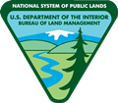
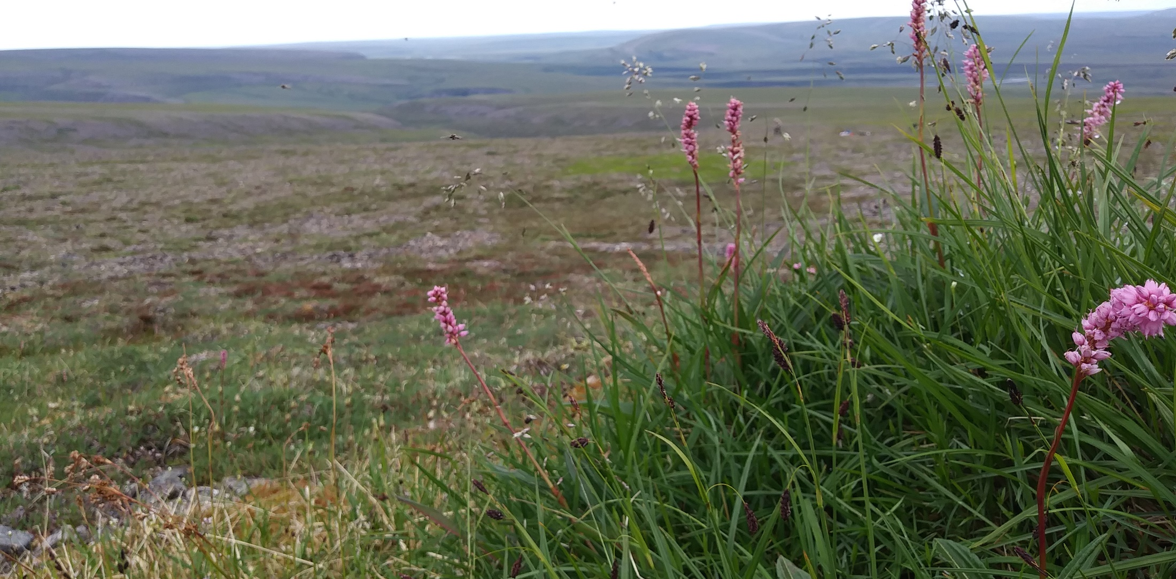
Developing Management Questions and Monitoring Objectives
U.S. Department of the Interior Bureau of Land Management
Notes:
Hello, My name is …. In this presentation we are going to cover the process of developing management questions and monitoring objectives

Slide 2
Objectives
After this presentation, you will be able to:
Define management and monitoring objectives
Explain importance of developing clear objectives
Set good objectives in different management scenarios
Notes:
By the end of this presentation, you should have a clear definition of management questions and monitoring objectives.
You should also understand the importance of developing clear objectives early in the process and be able to set good objectives in different management scenarios.
With that, let's get into a bit more into the nitty gritty and start talking about the details of setting up or continuing an AIM project

Slide 3
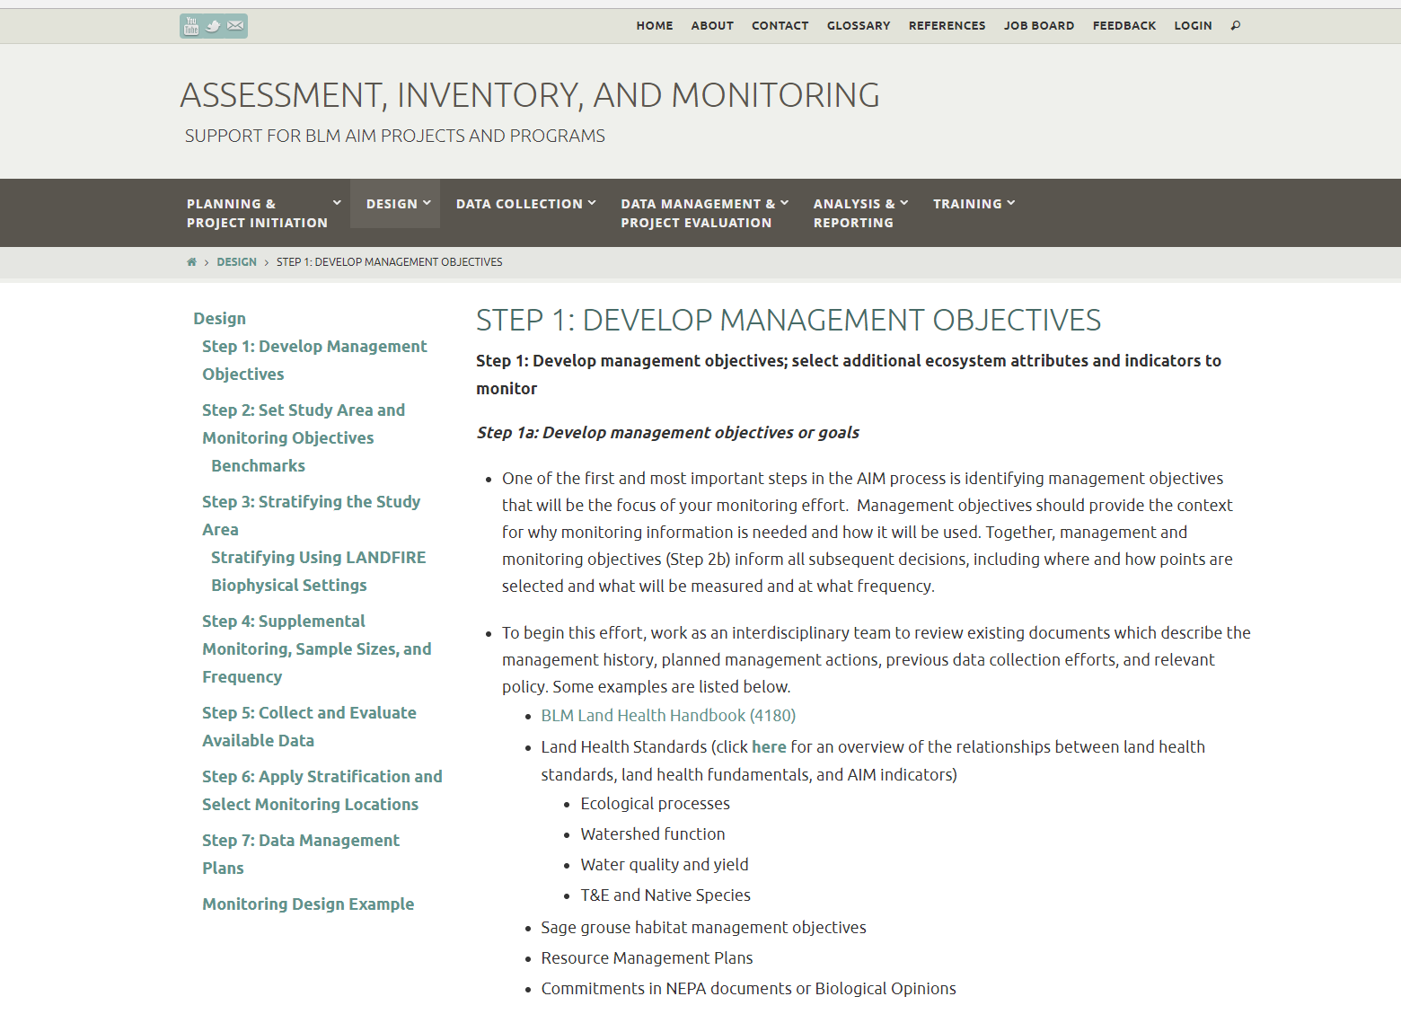
U.S. Department of the Interior Bureau of Land Management
aim.landscapetoolbox.org
Notes:
On aim.landscapetoolbox.org you can find a step-by-step guide to help you fill out your monitoring design worksheet as well as other information and resources to help you develop your AIM project. If you need additional help or references, remember to check it out!

Slide 4
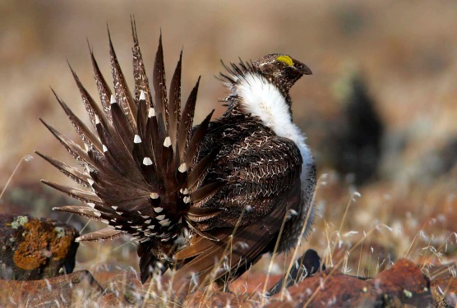
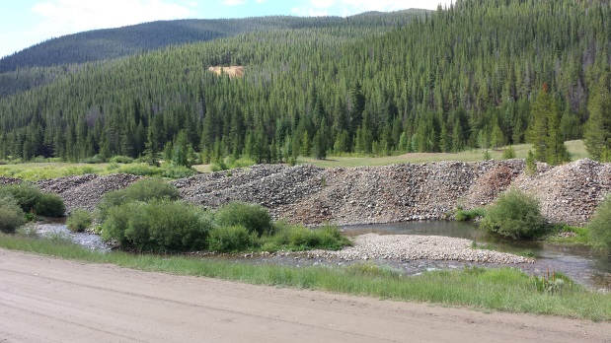
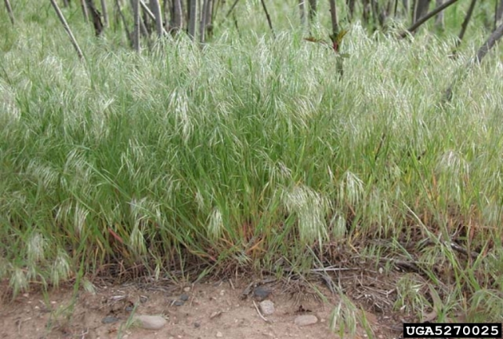
Management questions→ monitoring objectives
Management questions relate to management actions
Monitoring objectives explain specifically how we answer management questions
Is the stocking rate on this allotment compatible with sage-grouse habitat?
Is this road-crossing causing sedimentation in the stream?
Did the post-fire seeding reduce cheatgrass establishment?
Notes:
How do you go from management questions to monitoring objectives?
Management questions relate directly to management actions
Here are some examples of management questions that might be used to develop monitoring objectives.
Is the stocking rate on this allotment compatible with sage-grouse habitat?
Is this road-crossing causing sedimentation in the stream?
Did the post-fire seeding reduce cheatgrass establishment?
When you are developing your management questions, you can and often should include land health standards and RMP goals.
The next step is developing monitoring objectives that articulate specifically how we answer our management questions
Management questions act as goals: The goal is what you tell congress
Monitoring objectives are what you use within your project to evaluate those goals

Slide 5
Importance of developing clear monitoring objectives
Monitoring objectives dictate:
Poor objectives lead to poor decisions
Why am I collecting data?
Analysis and Reporting
Design
Methods
Notes:
It is really important to develop clear monitoring objectives
The first question we should always ask is “Why am I collecting data? What is my end product?”
Asking the "why" first will help improve data collection, analysis, and reporting.
The monitoring objectives dictate:
The sample design – the where, when and how often of your data collection
The sample methodologies, for example whether you include supplemental indicators
And analysis and reporting
Doing the work upfront of creating monitoring objectives will make analysis and decision-making simpler and more efficient. Vague questions can confound decisions about adaptive management, monitoring directions, and program outcomes which make it much harder to interpret your results
As we all know, the better we can explain and justify our decisions, the better we will do if it comes to litigation.

Slide 6
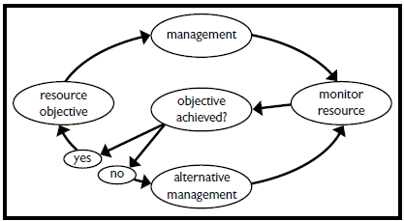
Importance of developing clear monitoring objectives
Cornerstones of adaptive management
Describe desired outcomes
Management actions to achieve outcomes
Benchmark for measuring success
Notes:
Clear monitoring objectives are the cornerstone of adaptive management.
Clear objectives help us describe desired outcomes and determine management actions that will help us. If you don’t have a good objective then you can’t make the yes/no decision in order to change management. The more you do upfront, the more you avoid having unrealistic or completely unobtainable objectives.
In this process, there can be many objectives working towards the management goal. Rather than looking at any single objective and whether it has been met, we should be considering all the objectives that are working towards the goal.
A good analogy would be your car: if your car is not running well, you might need to look at several different things such as the oil level, the engine temperature, etc.
Similarly if your goal is not being met, you should look at all of the objectives aimed towards that goal and evaluate which ones are successful.

Slide 7
Tips for developing sound monitoring objectives
Strive for clear, concise, quantifiable statements
Be specific:
What are you measuring?
Where/when is your target population
Develop multiple monitoring objectives per goal within each area
Notes:
When you are developing monitoring objectives it helps to make them clear, concise and quantifiable.
It also really helps if they are specific, specify not only what you are measuring but also the expected magnitude and direction of change.
Specify the monitoring target: that is, what are you wanting to measure or know about where? This would be ecological indicators and the target population or inference area.
You also want to develop multiple monitoring objectives for each management question within each area because rarely will one objective cover all facets of a question

Slide 8
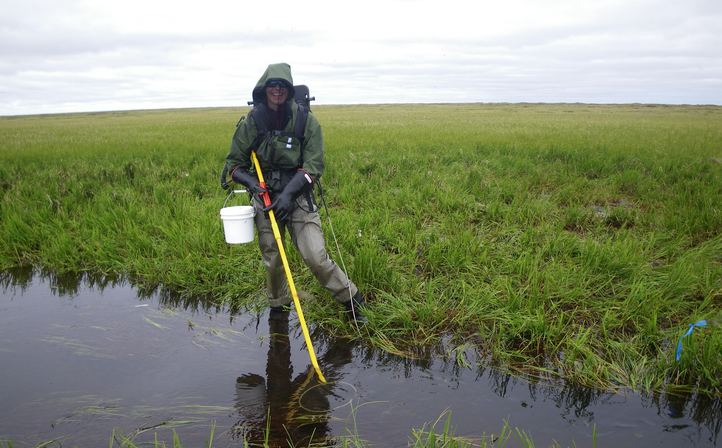
Basic monitoring objective formula
Study area + Indicator + Benchmark + % achieving + Confidence level + Time Period
Notes:
So we have a basic monitoring objective formula.
You might recognize this if you have done something like an Emergency Stabilization & Rehabilitation plan or a vegetation treatment; it's very similar to the formulas used there.
Your monitoring objective should specify:
your study area, the indicator of interest
the benchmark
the per of the target that should be achieving the benchmark, also known as a threshold for management action
the confidence level you want to have about the estimate
and the time period in which you want it to happen.

Slide 9
Management questions - examples
Condition (baseline sampling for determinations of biological condition):
What is the composition of vegetation within the Mill Creek watershed?
Trend (repeat baseline sampling for biological condition):
Are vegetative attributes within the Mill Creek allotment changing through time?
Treatment effectiveness (results of direct management action):
How did Mill Creek respond to a willow planting?
Impact assessment (lawsuit: perceived grazing induced habitat degradation):
Does grazing impact sage-grouse forb availability?
Notes:
Here we will talk about different types of management questions and give an example of what that might look like.
Condition is the baseline sampling: What does it look like right now? So an example might be:
What is the composition of vegetation within the Mill Creek watershed?
Trend is a repeated baseline sampling of that biological condition. A trend related management question might be:
Are vegetative attributes within the Mill creek allotment changing through time?
Treatment effectiveness refers to a specific management action we have taken. For example, if we had a willow planting, then our management question could be:
How did Mill Creek respond to a willow planting?
We might also ask impact assessment-type questions. In the case of a lawsuit there will often be the perception that grazing has had a negative impact and caused habitat degradation so our management question might be:
Does grazing impact sage-grouse forb availability?

Slide 10
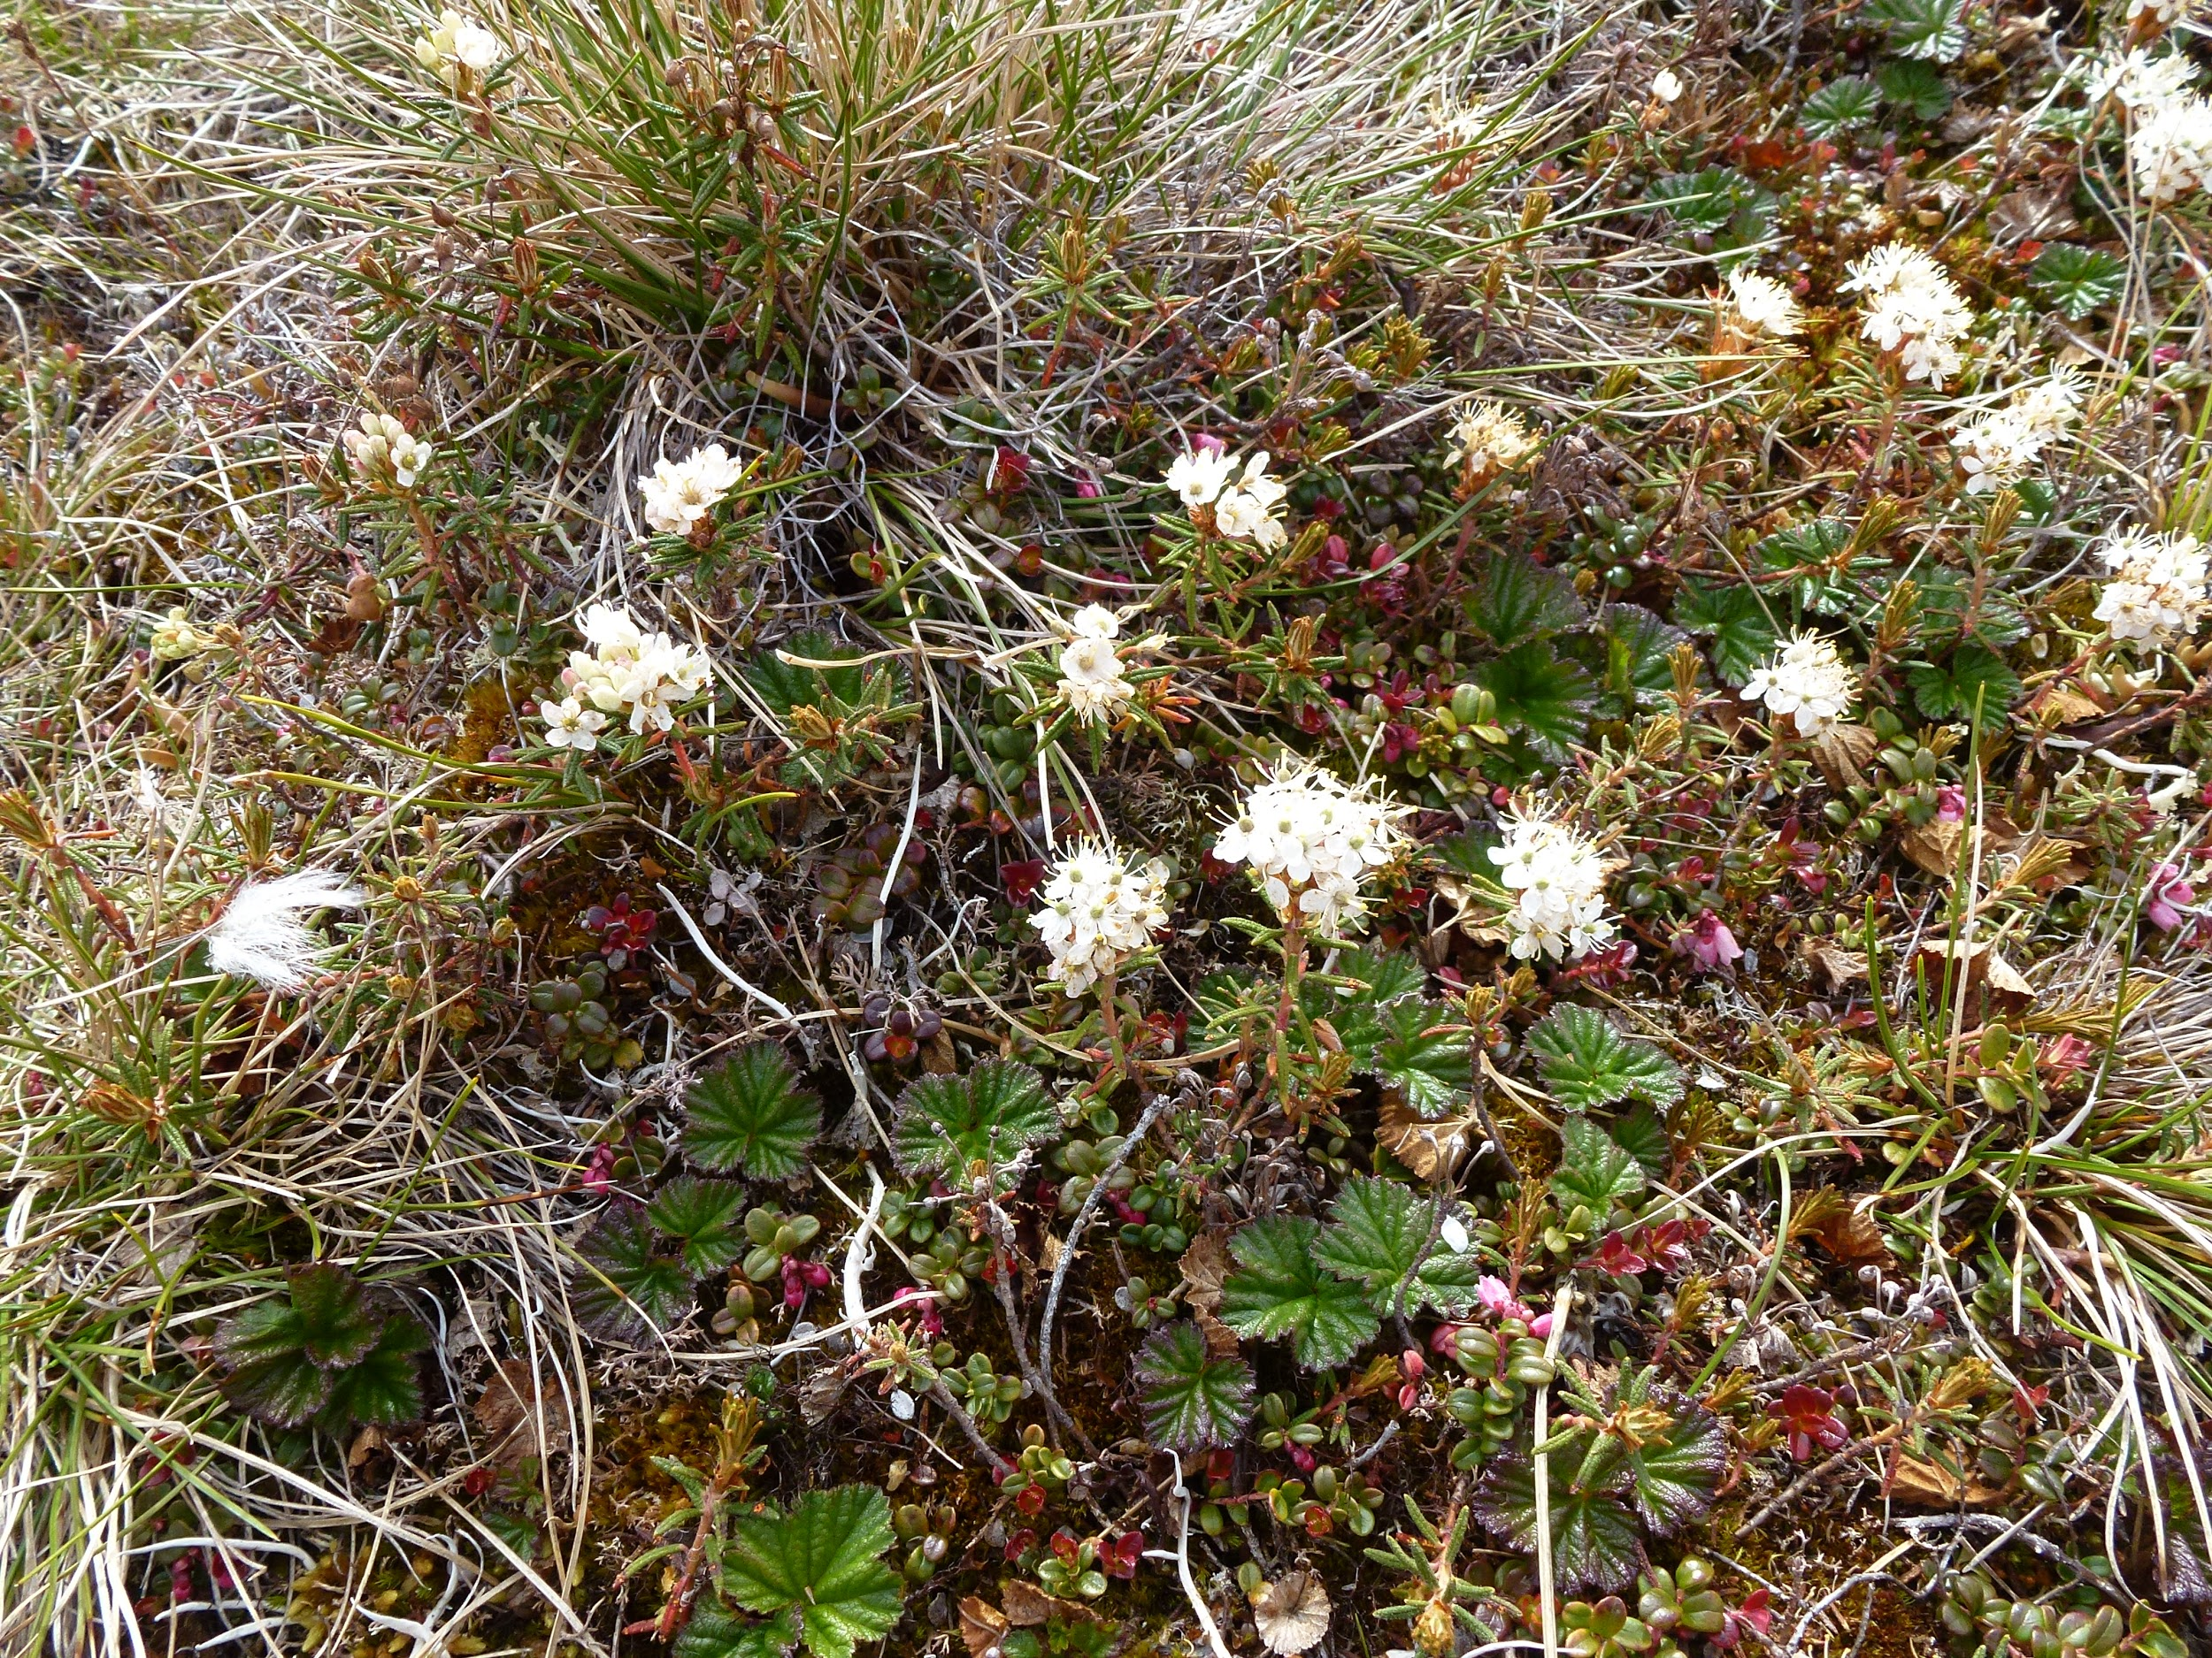
Monitoring objectives examples
Condition (baseline sampling for determinations of biological condition):
Q: What is the composition of vegetation within the Mill Creek watershed?
Objective: Total perennial grass cover should be between 25% and 65% on 75% of the Mill Creek watershed with 80% confidence in 2017
Notes:
From these management questions, we then develop monitoring objectives.
So if our management question was, "What is the composition of vegetation within the Mill creek watershed," we would develop our monitoring objectives using the formula we saw earlier. If one of our relevant vegetation composition indicators was total perennial grass cover, we could fill out the formula with:
Total perennial grass cover as our indicator, plus
25% to 65% as our benchmark,
75% as our percent of the area that we want to be achieving the benchmark,
Mill Creek as the study area,
80% as the confidence level,
And "by 2017" as the timeframe.
Stringing those together into a statement, we get: "Total perennial grass cover should be between 25% and 65% on 75% of the Mill Creek watershed with 80% confidence in 2017."
Note that this is just one objective that this monitoring question could prompt. If there are other vegetative indicators that answer the monitoring question, each one would get a monitoring objective
We can refine our objectives over time and we can apply post-hoc (after the fact) questions. You may find that perennial grass cover is fine but dsicover that there are a high number of non-native species and that that should get its own monitoring objective.
In this example we said 75% of the area. That gives some wiggle room because we can still meet the objective even if not everywhere is perfect and falls within that that 25-65% total perennial grass cover.
You might not even want 100%! For example, if you want a mosaic of perennial grass and shrub cover then 100% of either would be counterproductive.

Slide 11
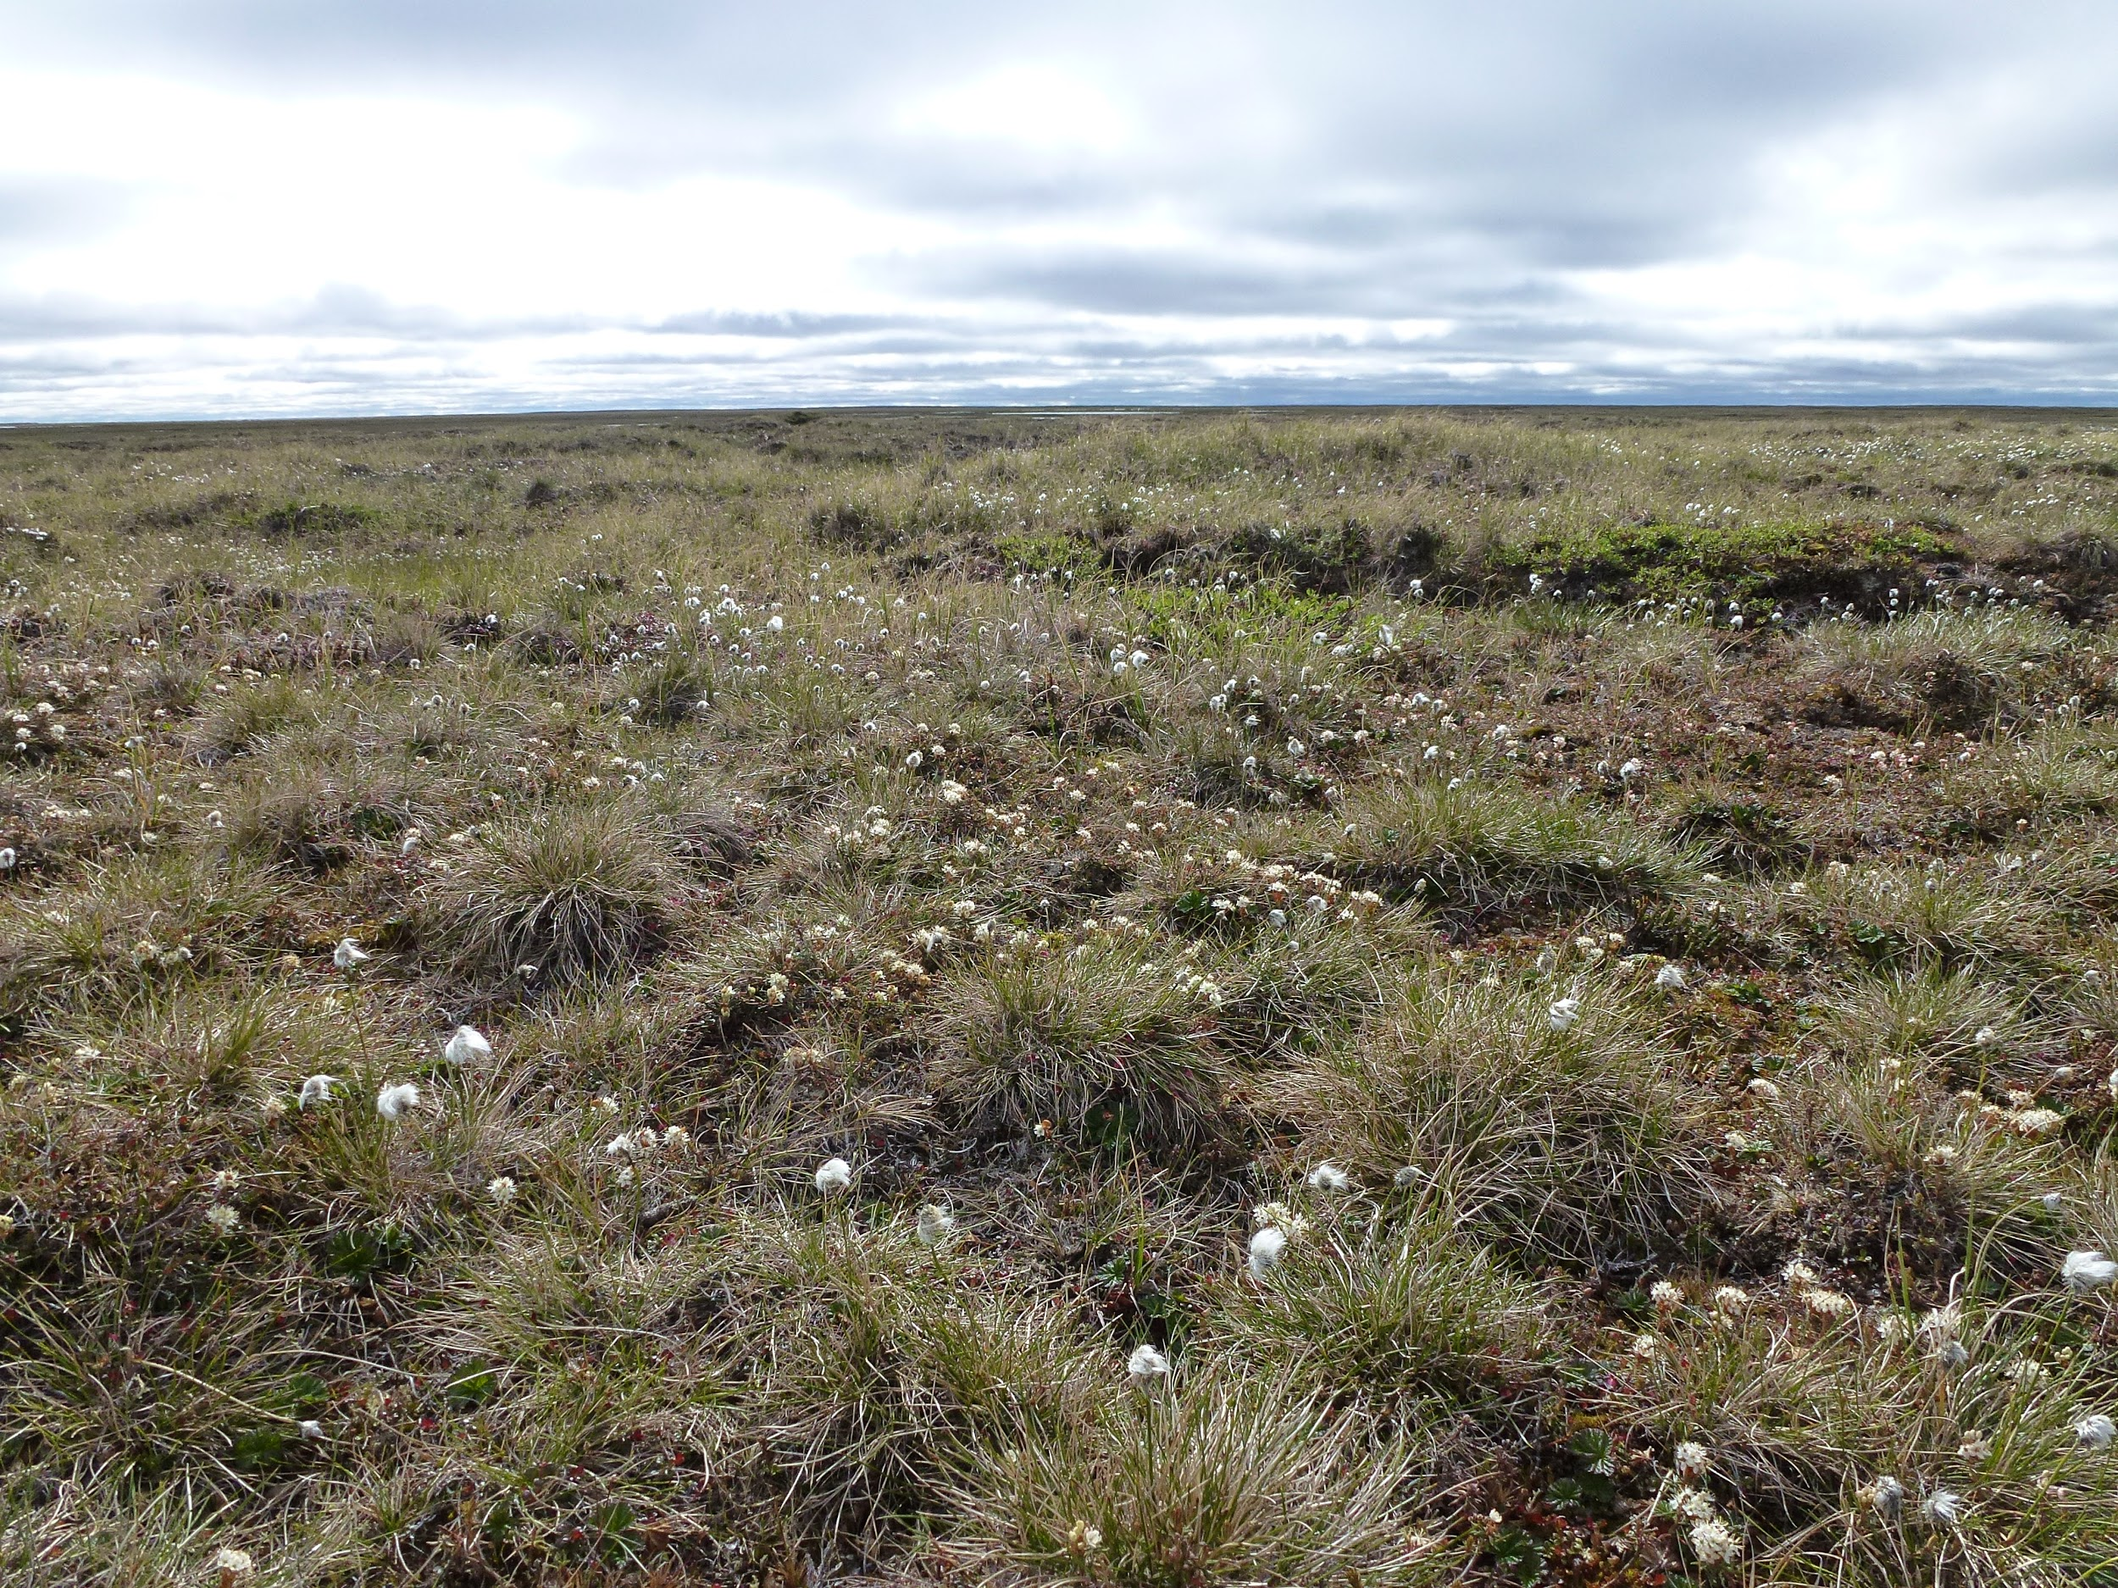
Monitoring objectives examples
Trend (repeat baseline sampling for biological condition):
Q: Are vegetative attributes within the Mill Creek watershed changing through time?
Objective: Perennial grass cover in the Mill Creek watershed should have increased by at least 25% over the last three years with 90% confidence
Notes:
Let's revisit our trend management question example: Are vegetative attributes within the Mill Creek watershed changing though time?
An objective, again using our same monitoring objective formula, might be, "Perennial grass cover in the Mill Creek watershed should have increased by at least 25% over the last three years with 90% confidence"
Trend is hard to determine and often requires a lot of data. There are a couple ways to get trend estimates.
One way would be repeatedly visiting the same plots and counting how many meet the objective each time. Trend can also be determined for an area using a weighted analysis with a larger sample size.
As an example, I could be surveying peoples' opinions on a subject over time in an area.
With plot counting, I would ask the same group of people repeatedly over time (maybe every 5 years) what their opinion on the subject was.
To do a weighted analysis approach I could ask a whole bunch of people what their opinion on the subject was and then in 5 years I would ask a different bunch of people in the same area what their opinion was. If I select my people randomly from the same overall population, I don’t need to ask the same people and I can still get a good idea of how peoples opinions have changed in that area.

Slide 12
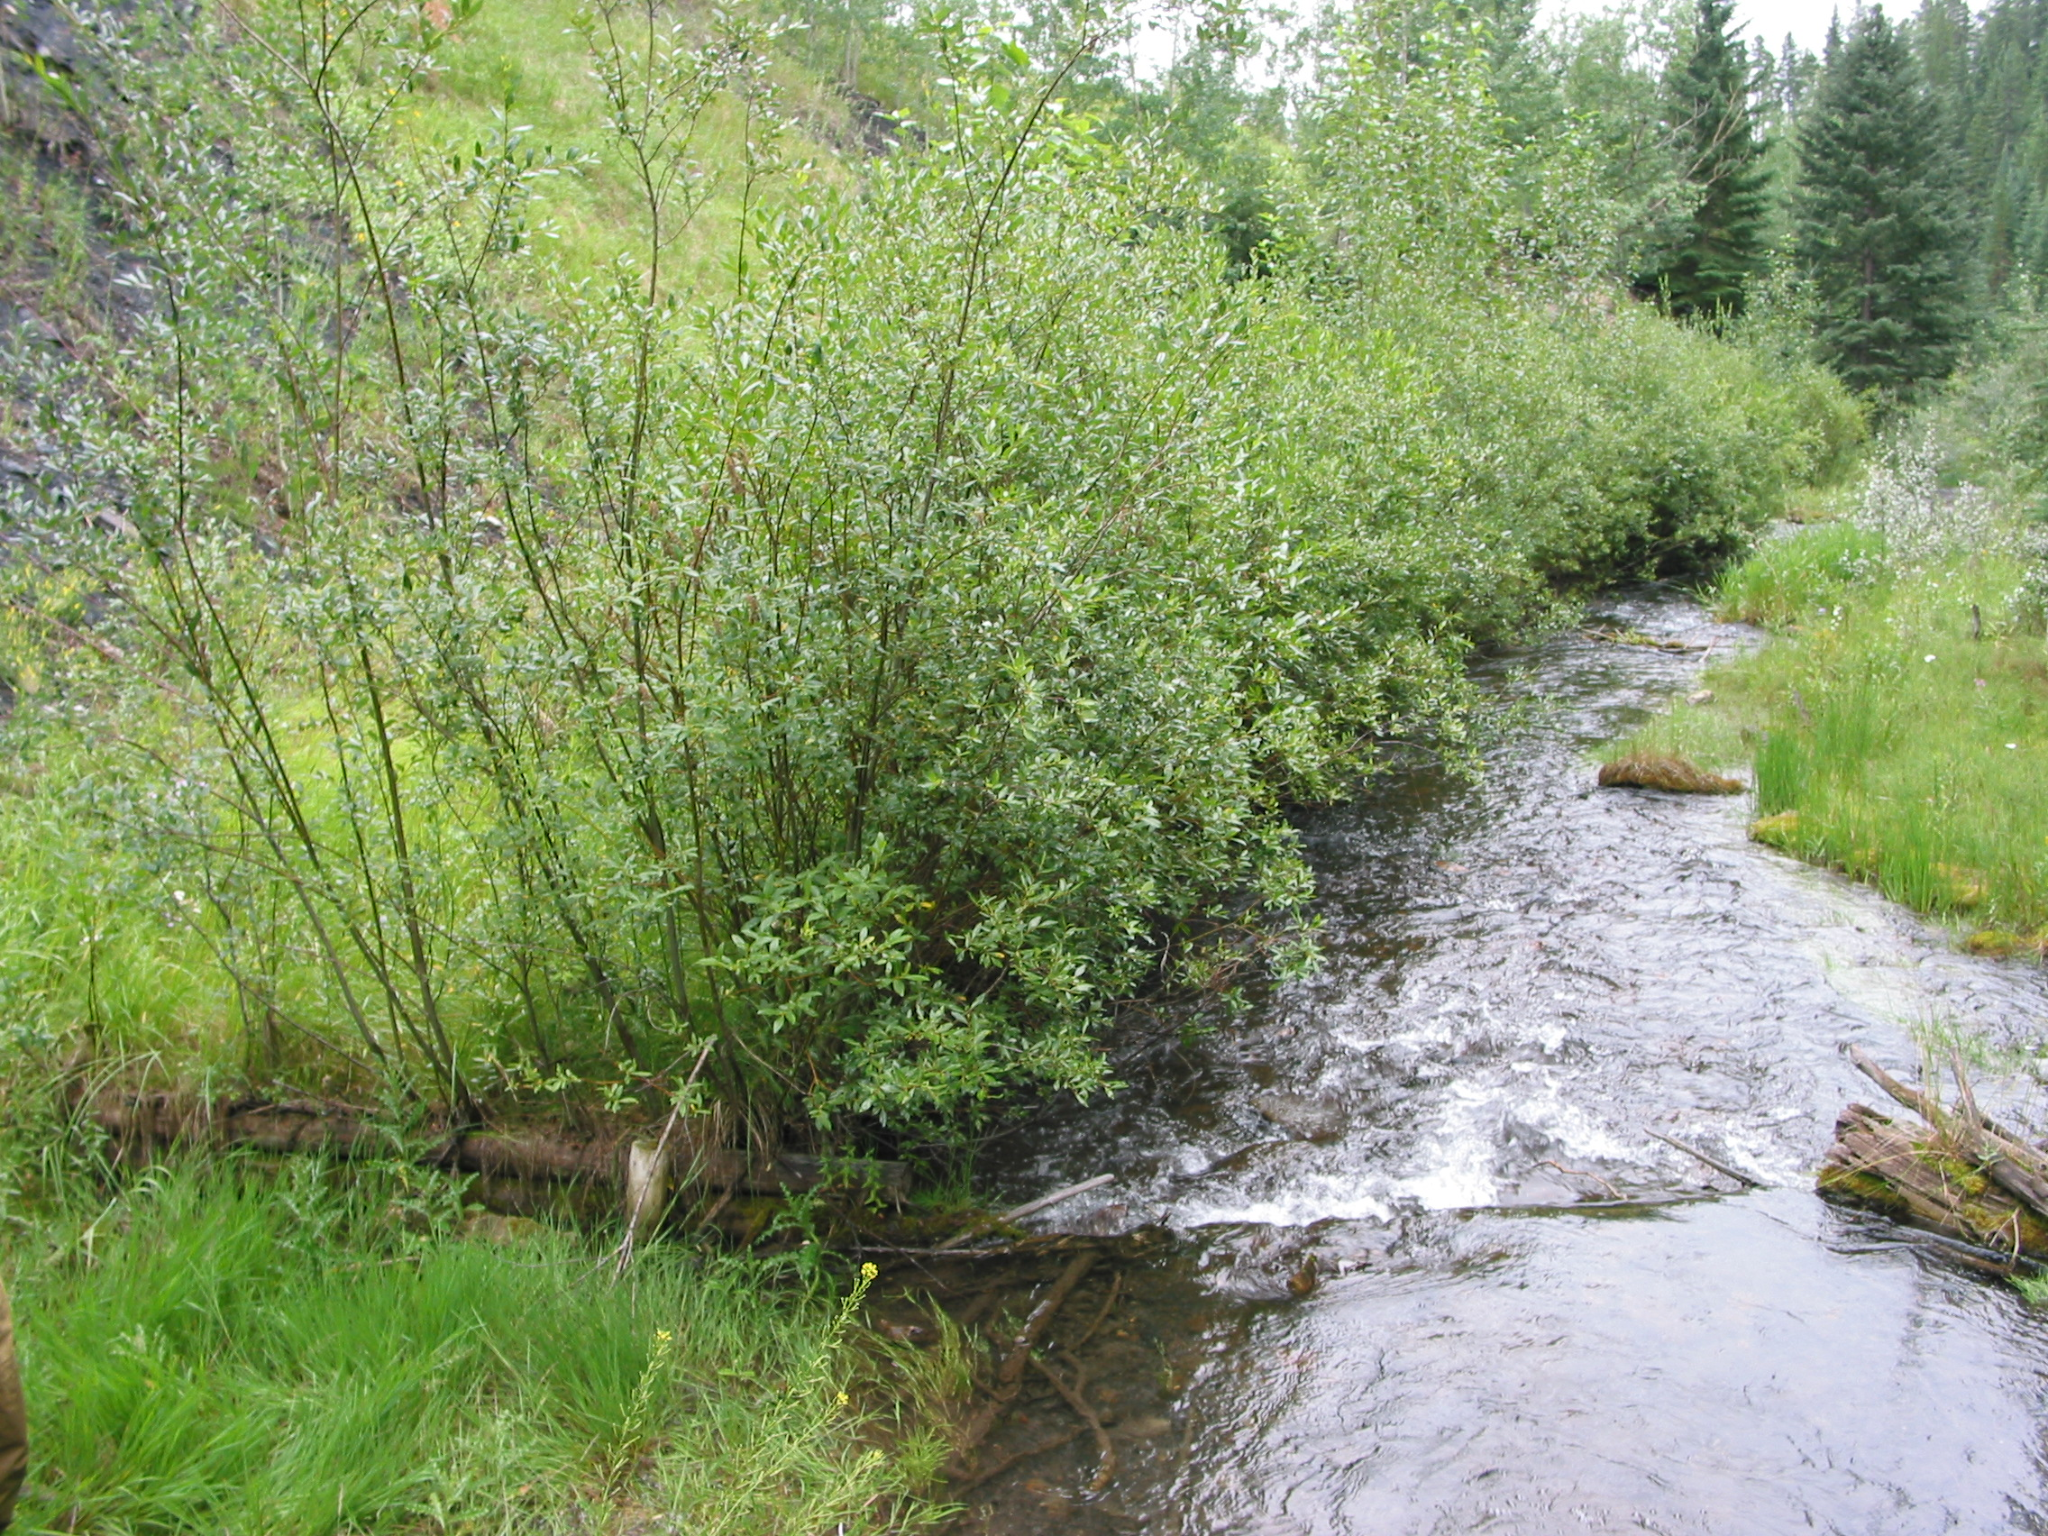
Monitoring objectives examples
Treatment effectiveness (willow planting):
Q: How did Mill Creek respond to a willow planting?
Objective: At least 50% of the willow poles planted in the Mill Creek floodplain should survive the 1st three years post treatment
Notes:
In this example our management question was about treatment effectiveness: "How did mill creek respond to a willow planting?"
A monitoring objective might say that we wanted to see that, "At least 50% of the willow poles planted in the Mill Creek Floodplain should survive the firs^{t} three years post-treatment." If we stuck strictly to the formula and didn't worry about making it readable, we would phrase this as, "Willow pole survival rates should be greater than 50% within the Mill Creek Floodplain after three years post-treatment with 80% confidence"
This is a pretty common type of question we might ask in Emergency Stabilization and Rehabilitation projects: we frequently have management questions like, "Did our seeding treatment work? "

Slide 13
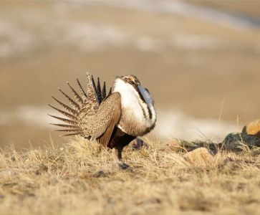
Monitoring objectives examples
Impact assessment (lawsuit: perceived grazing induced habitat degradation):
Q: Does grazing impact sage-grouse forb availability?
Objective: There should be a 10% increase in sage-grouse preferred forb cover in the Home Camp allotment five years following a change from season-long grazing to rest-rotation, with 90% confidence
Notes:
Our impact assessment question example was, "Does grazing impact sage-grouse forb availability?"
Because this is looking for a cause, the monitoring objective needs to reflect change over time in some forb-related indicator in response to a change in grazing management, so our objective could be written out:
There should be a 10% increase in sage-grouse preferred forb cover in the Home Camp allotment five years following a change from season-long grazing to rest-rotation, with 90% confidence.
Conceptually, these aren't far off from treatment effectiveness, but you are may not have control over what has changed

Slide 14
Basic monitoring objective formula
What is the composition of vegetation within the Mill Creek watershed?
Study area + Indicator + Benchmark + % achieving + Confidence level + Time Period
Notes:
Developing your objective sentences well can be a lot of work and really frustrating. Maybe feels like writing these is overkill, but doing this work upfront is going to make everything easier and more straightforward throughout the process and will really help clarify your AIM project planning. These will help inform the what, where, and how of data collection.
Having these clear objectives from the beginning also helps improve clarity of your analysis and evaluation of management actions
And remember: This is a part of adaptive management so there is flexibility to change these down the road if need be.

